Slide 1
Agenda
Escalation Paths
  Let’s identify where different cases should be escalated
Mandatory INV Escalations
Let’s learn how to recognize cases that must go to INV escalations
Handling Escalations
Let’s learn how to safely handle escalations from CS and other TA employees
Writing Clear Escalations
Let’s learn how to provide the right context and proposed action
Avoiding Escalation Mistakes
Let’s identify which mistakes to avoid when handling escalations
Tripadvisor / Fraud support / Agenda

Slide 2
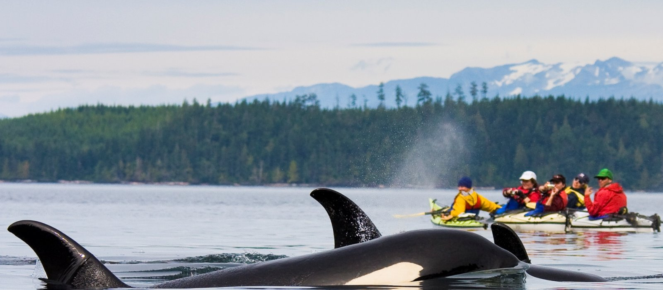
Canada
01. FS - Internal Escalations

Slide 3
What Is an Escalation?
When you encounter an uncertain case and need more clarity, an escalation moves a case to someone with the right expertise, authority, or access to resolve it.
Think of escalation as answering three questions:
Handle yourself
Can I handle it?.
Use the available KB and policies.
Do I need a second opinion?
Send to SGS Second Opinion / Team Lead.
Second opinion
Does it require specialist handling?
Send to Tier 2, INV, CS, Community, Places, or the relevant partner.
Specialist escalation
Tripadvisor / Fraud support / What is an escalation

Slide 4
What is SGS Second Opinion
Give the abbreviation for SGS and what happens what we escalate to SGS - like agents escalates to TLs for more clarity?
Escalate to SGS Second Opinion when:
Every Escalation Needs
  The KB does not provide an answer.
  The case is highly complex or an edge case.
  The issue is a general inquiry that is not already directed to Tier 2.
What you checked
Your specific question
Your proposed action (If applicable)
Tripadvisor / Fraud support / What is SGS second opinion

Slide 5



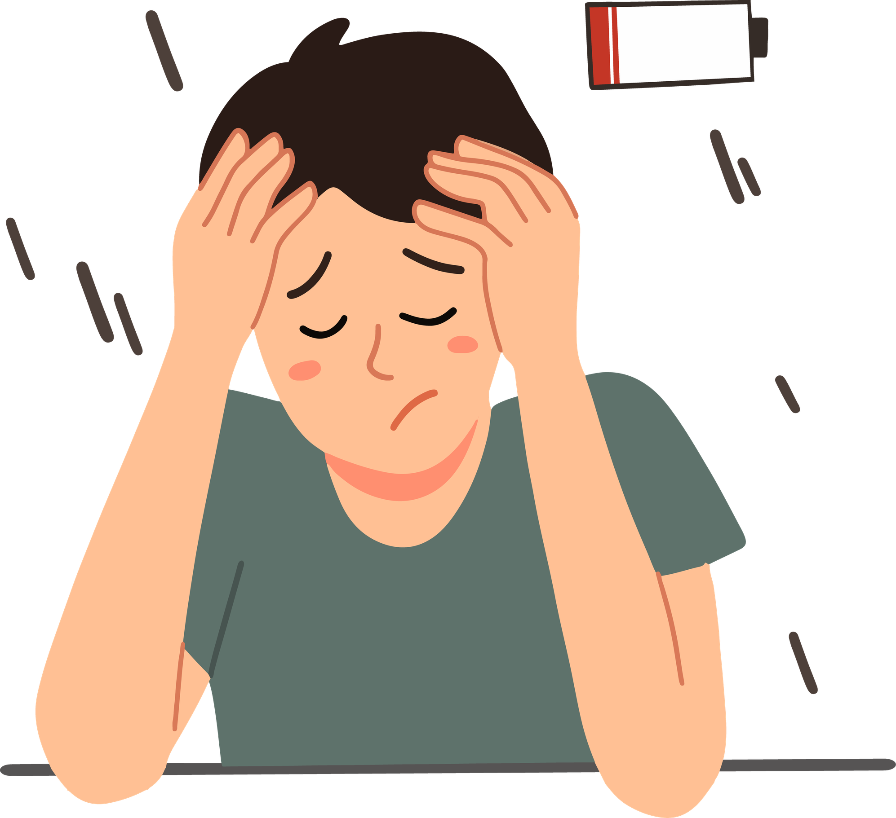



When to Escalate to Tier 2
Extreme bullying: Threats or interference with personal/professional life
  Undocumented edge cases — Team Lead only
Sensitive subjects: Death, sexual assault, drugging, animal cruelty, violence
  Technical issues: Repeated verification failures or AI/ChatGPT filtering errors
Escalate to Tier 2
Exhausted resources
Incentives
  Legal / Police correspondence
  Wider technical bugs/system failures
  Press / Media inquiries or credible media threats
  Unclear escalations from CS or Community
  GDPR / Privacy concerns
Tripadvisor / Fraud support / When to escalate to Tier 2

Slide 6
How to Escalate Correctly
SGS Second Opinion
Tier 2
Returning a Second Opinion ticket
  Apply “Escalate/Transfer::To SGS Second Opinion”
  Complete the internal comment with relevant information.
  Team Leads process the queue within 72 hours.
  Reassign to the original agent
  Select the Fraud Support Group
  Uncheck “Escalate to SGS Second Opinion”
  Submit as Open
  Apply “To FS Tier 2”
  Add all relevant information to the internal comment.
Tripadvisor / Fraud support / How to escalate correctly

Slide 7
Canada
02. Escalations from Other Teams

Slide 8
Handling Customer Support Escalations
CS escalations arrive from:
help@tripadvisorsupport.com
Before responding, check:
Requester
Note type
Is it the owner/user?
Is the CS message an Internal Note?
If Zendesk fails to set it correctly:
  Events → “Make this comment an internal note”
  Copy the owner's email from the ticket
  Replace the requester with the owner's email
Tripadvisor / Fraud support / Handling CS escalations

Slide 9



Escalations from Other TA Employees
When a TA employee emails about a property:
Acknowledge the colleague and thank them
Say you'll continue the conversation directly with the owner
Do not provide further case details to the employee
Acknowledge
Speak
Do not provide
Search Zendesk for an existing owner conversation
If none exists, create a ticket for the owner
Quote the employee's original inquiry in Internal notes
Search
Create
Quote
Note: “Why do we document the original colleague inquiry internally? ”Because it preserves context without exposing internal information externally.
Important Exception
If a verified/registered owner uses an @tripadvisor.com address, don't reply to that address as though they are the colleague, communicate with the actual owner.
Tripadvisor / Fraud support / Escalations from Other TA employees

Slide 10

URD Escalations: Know What the Ticket Means
The URD escalation option determines what kind of Zendesk ticket is created.
Create Investigation Case
Fraud – Escalated Review
Investigations Team
Potential CI Investigation Lead
Fraud Escalation – Red Badge Recommendation
General Escalation
Tripadvisor / Fraud support / URD escalations
Notes:
The important takeaway is not memorizing every label—it is understanding that different URD selections route cases differently.

Slide 11
Canada
03. Escalations to Other Teams

Slide 12
Investigations Team: High-Risk & Large-Scale Fraud
INV handles large-scale fraud and high-sensitivity cases that require specialist investigation.
Mandatory INV escalation topics include:
Impersonation
Restrictions
Important exception
Red Badge cases
Branding misuse
Never overturn an INV removal.
If you believe INV removed something incorrectly:
➡️ Escalate to FS Tier 2.
Media / Lockdown badges
Organized paid-review patterns
Review Gating
Project Nomen
Tripadvisor / Fraud support / Investigations team

Slide 13

INV: Location Notes & Continuity
Location Notes can give direct instructions about who must handle a fraud case.
Expand Location Notes in Location Center and if you see:
“FRAUD SUPPORT TO BE HANDLED BY INVESTIGATIONS”
If an Investigator previously handled the same issue for a property:
Assign the ticket to INV Support immediately using the Note Present macro.
Continuity rule
Assign the new ticket back to that Investigator.
Tripadvisor / Fraud support / INV: Location notes & continuity

Slide 14
How to Escalate to INV
A clear INV escalation gives investigators the facts they need without unnecessary detail.
Steps
  Select Escalate/Transfer → To Investigations
  Add a brief summary of the issue
  Submit as Open
Tripadvisor / Fraud support / How to escalate to INV

Slide 15
Review Gating vs. Restrictions
Both Review Gating and Restrictions can manipulate or suppress reviews, but they are not the same thing.
All guests are required to agree to a “no review” condition as part of booking.
The property pre-screens guests and only encourages positive-experience guests to review.
01
01
Restrictions
Review
Gating
Example:
“If you had a positive experience, please review us on Tripadvisor. If negative, tell us privately.”
Example:
“Guests agree not to write a review about their experience as part of this booking agreement.”
Restrictions
VS
Review Gating
02
VS
02
03
03
➡️ Escalate to INV
➡️ Escalate to INV
  Tripadvisor does not help owners enforce these agreements.
  A review should not be removed simply because a user agreed not to review in exchange for a refund.
REMEMBER
Tripadvisor / Fraud support / Review gating vs restrictions

Slide 16



Escalating to Other Teams
Not every case belongs with Fraud Support: route non-fraud issues to the team best equipped to handle them.
For issues with no fraud/moderation component.
Example:
    Password/account access
    Changing listing name/closure
Action: Clean FS jargon → summarize → Submit as Solved
For:
User-to-user bullying
Problematic profile photos
Account deletion
Forum/Q&A content
Action: ?????????
Customer Support
Community
For listing problems that don't need a reply.
Action: Owner requests needing a reply → CS instead.
Places
Tripadvisor / Fraud support / Escalating to other teams

Slide 17


Partner Escalations & Unclear Tickets
Partner cases have specific routes, while unclear internal escalations should be handled deliberately
Viator
Customers: Direct non-review issues to exp-cscare@viator.com
Owners/Suppliers: Handle as best you can. If stuck → FS Tier 2 – Viator Inquiry
The Fork
Review disputes: Direct owners to The Fork Manager
Vacation Rentals
Non-fraud VR tickets → Tier 2
Unclear CS tickets
Tier 2
Tier 2 can provide clarity and feedback to improve the originating team's escalation quality.
Tripadvisor / Fraud support / Partner escalations & unclear tickets

Slide 18
Escalation Cheat Sheet
Situation | Destination
KB gap / complex case | SGS Second Opinion
Legal, privacy, sensitive, major technical issue | Tier 2
Impersonation / Red Badge / Gating / Restrictions | INV
No fraud or moderation issue | CS
User-to-user/community issue | Community
Listing action with no reply needed | Places
Viator owner/supplier issue you cannot resolve | Tier 2 – Viator
Unclear CS escalation | Tier 2
Tripadvisor / Fraud support / Escalation cheat sheet

Slide 19


Discussion scenarios
Scenario 1:
A hotel requires every guest to sign a booking agreement saying they will never write a review.
Where does it go?
INV - Restrictions
Tripadvisor / Fraud support / Knowledge check

Slide 20
Discussion scenarios
Scenario 3:
A property sends positive-experience guests a Tripadvisor review link but tells unhappy guests to complain privately.
What is this?
Review Gating → INV
Tripadvisor / Fraud support / Knowledge check

Slide 21
Discussion scenarios
Scenario 5:
INV previously removed content for a property. You believe the removal was wrong.
Can you restore it yourself?
NO! Escalate to FS Tier 2
Tripadvisor / Fraud support / Knowledge check

Slide 22
KNOWLEDGE CHECK
Which situation belongs in SGS Second Opinion?
A Red Badge case
A KB gap where you need a second opinion
A password reset
A user requesting account deletion
Tripadvisor / Fraud support / Knowledge check

Slide 23

KNOWLEDGE CHECK
True or False?
Review Gating and Restrictions must be escalated to
INV
TRUE
FALSE
That's right, keep it
up!
Tripadvisor / Fraud support / Knowledge check

Slide 24
KNOWLEDGE CHECK
What is the best escalation comment?
“Please advise.”
“I don't know what to do.”
“I checked X and Y. Neither covers this case. I recommend A because ____. Can you confirm?”
“Urgent!!!”
Tripadvisor / Fraud support / Knowledge check

Slide 25
KNOWLEDGE CHECK
Which is an INV escalation?
Owner wants to change a listing name
User forgot their password
Property uses review gating
User wants to delete their account
Tripadvisor / Fraud support / Knowledge check

Slide 26
KNOWLEDGE CHECK
True or False?
If INV made a removal you disagree with, you can overturn it yourself
TRUE
FALSE
Superb, you've got the
correct answer
Tripadvisor / Fraud support / Knowledge check

Slide 27
KNOWLEDGE CHECK
A listing issue needs an action but no reply to the requester. Which team is appropriate?
Places
Community
CS
INV
Tripadvisor / Fraud support / Knowledge check

Slide 28
KNOWLEDGE CHECK
You receive an unclear CS escalation. What should
you do?
Guess and resolve it
Send it to Community
Escalate to Tier 2
Send it to the owner immediately
Tripadvisor / Fraud support / Knowledge check

Slide 29
KNOWLEDGE CHECK
True or False?
A case should always go to Tier 2 when an agent finds
it difficult
TRUE
FALSE
Perfect, that's the
correct response
Tripadvisor / Fraud support / Knowledge check

